Slide 1
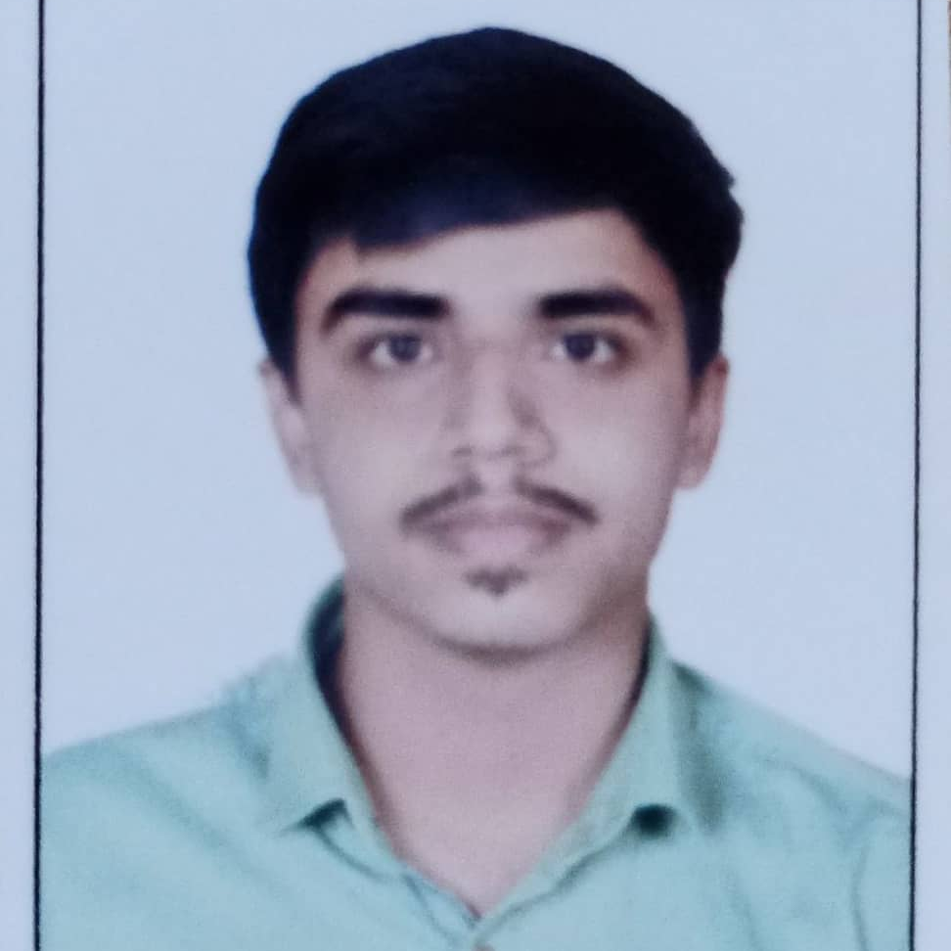


Mohnish Bhonde
Intern
Bachelor of Engineering in Mechanical Engineering : 2018 - 2022
Skills Java 11
Spring Boot, MVC
Spring Security
Bootstrap
MEAN Stack
Angular
NodeJS
MongoDB
Database
SQL database – MySQL
No SQL database – MongoDB
Web Technologies
HTML5 & CSS3
Javascript
Typescript
AddOns
Github
Maven
Postman
Additional Details
Communication Skills
Team management
Leading Skills
mohnish2351999@gmail.com
+91 8668338072
A4
Software Engineer who is Strong in design and integration with intuitive problem-solving skills. Passionate about implementing and launching new projects.
Ready to learn new technologies and implement them to further improve my knowledge.
Eager to work in a team of dedicated people and serve a key role in the enhancement and development of the project.
Has working knowledge on Angular and Java Microservice Development using Spring framework on an intermediate level.
1. Deals and Coupons Finder App Web Application
Completed end to end case study of Deals and Coupons Finder App along with JWT authentication, Swagger and payment testing using Spring Boot and Angular. Angular Material and Bootstrap used for user interface.
2. Backend (MongoDB), Midware (Spring Boot) and Frontend (Angular) at Capgemini Degreed Platform
Learned and recompiled all concepts of the backend, midware and frontend to polish my skills to work on real –time projects.
Github video Link: https://github.com/MohnishBhonde/Assignments/tree/main/Deals%20And%20Coupons%20Finder%20App%20video%20and%20resume

